Slide 1
Process Control

Slide 2
Process Identifiers
Every process has a unique process ID, a non-negative integer. Because the process ID is the only well-known identifier of a process that is always unique, it is often used as a piece of other identifiers, to guarantee uniqueness.
For example, applications sometimes include the process ID as part of a filename in an attempt to generate unique filenames.

Slide 3
Although unique, process IDs are reused. As processes terminate, their IDs become candidates for reuse.
Process ID 0 is usually the scheduler process and is often known as the swapper. No program on disk corresponds to this process, which is part of the kernel and is known as a system process.
Process ID 1 is usually the init process and is invoked by the kernel at the end of the bootstrap procedure.

Slide 4
The init process never dies. It is a normal user process, not a system process within the kernel, like the swapper, although it does run with superuser privileges.
Process ID 2 is the pagedaemon. This process is responsible for supporting the paging of the virtual memory system.
In addition to the process ID, there are other identifiers for every process. The following functions return these identifiers.

Slide 5
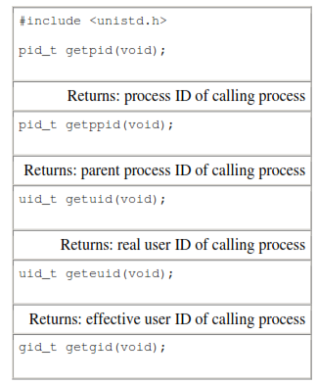

Slide 6
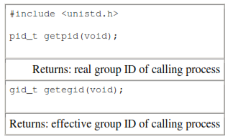

Slide 7
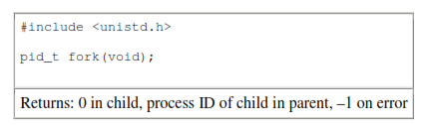
fork Function
An existing process can create a new one by calling the fork function.

Slide 8
The new process created by fork is called the child process. This function is called once but returns twice.
The only difference in the returns is that the return value in the child is 0, whereas the return value in the parent is the process ID of the new child.
The reason the child's process ID is returned to the parent is that a process can have more than one child, and there is no function that allows a process to obtain the process IDs of its children.
The reason fork returns 0 to the child is that a process can have only a single parent, and the child can always call getppid to obtain the process ID of its parent.

Slide 9
Both the child and the parent continue executing with the instruction that follows the call to fork.
The child is a copy of the parent. For example, the child gets a copy of the parent's data space, heap, and stack.
Note that this is a copy for the child; the parent and the child do not share these portions of memory. The parent and the child share the text segment.

Slide 10
File Sharing
The kernel uses three data structures to represent an open file, and the relationships among them determine the effect one process has on another with regard to file sharing.
1. Every process has an entry in the process table. Within each process table entry is a table of open file descriptors, which we can think of as a vector, with one entry per descriptor. Associated with each file descriptor are
a. The file descriptor flags (close-on-exec; refer to Figure)
b. A pointer to a file table entry
2. The kernel maintains a file table for all open files. Each file table entry contains
a. The file status flags for the file, such as read, write, append, sync, and nonblocking;
b. The current file offset
c. A pointer to the v-node table entry for the file.

Slide 11
3. Each open file (or device) has a v-node structure that contains information about the type of file and pointers to functions that operate on the file. For most files, the v-node also contains the i-node for the file. This information is read from disk when the file is opened, so that all the pertinent information about the file is readily available. For example, the i-node contains the owner of the file, the size of the file, pointers to where the actual data blocks for the file are located on disk, and so on.

Slide 12
Figure shows a pictorial arrangement of these three tables for a single process that has two different files open: one file is open on standard input (file descriptor 0), and the other is open on standard output (file descriptor 1).

Slide 13
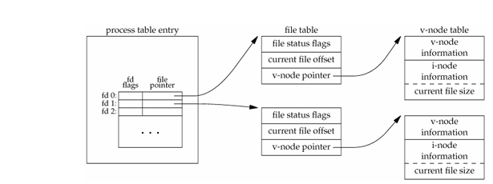

Slide 14
If two independent processes have the same file open, we could have the arrangement shown in next Figure. We assume here that the first process has the file open on descriptor 3 and that the second process has that same file open on descriptor 4. Each process that opens the file gets its own file table entry, but only a single v-node table entry is required for a given file. One reason each process gets its own file table entry is so that each process has its own current offset for the file.

Slide 15
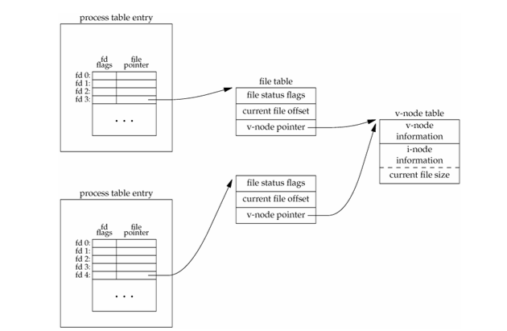

Slide 16
Given these data structures, we now need to be more specific about what happens with certain operations that we've already described.
• After each write is complete, the current file offset in the file table entry is incremented by the number of bytes written. If this causes the current file offset to exceed the current file size, the current file size in the i-node table entry is set to the current file offset (for example, the file is extended).
• If a file is opened with the O_APPEND flag, a corresponding flag is set in the file status flags of the file table entry. Each time a write is performed for a file with this append flag set, the current file offset in the file table entry is first set to the current file size from the i-node table entry. This forces every write to be appended to the current end of file.
• If a file is positioned to its current end of file using lseek, all that happens is the current file offset in the file table entry is set to the current file size from the i-node table entry. (Note that this is not the same as if the file was opened with the O_APPEND flag.)
• The lseek function modifies only the current file offset in the file table entry. No I/O takes place.

Slide 17
It is possible for more than one file descriptor entry to point to the same file table entry. This also happens after a fork when the parent and the child share the same file table entry for each open descriptor.
Note the difference in scope between the file descriptor flags and the file status flags.
The former apply only to a single descriptor in a single process, whereas the latter apply to all descriptors in any process that point to the given file table entry.

Slide 18
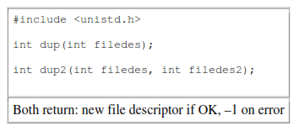
dup and dup2 Functions
An existing file descriptor is duplicated by either of the following functions.

Slide 19
The new file descriptor returned by dup is guaranteed to be the lowest-numbered available file descriptor.
With dup2, we specify the value of the new descriptor with the filedes2 argument. If filedes2 is already open, it is first closed.
If filedes equals filedes2, then dup2 returns filedes2 without closing it.
The new file descriptor that is returned as the value of the functions shares the same file table entry as the filedes argument

Slide 20
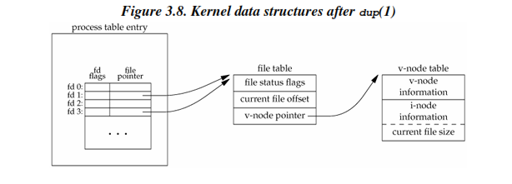

Slide 21
In this figure, we're assuming that when it's started, the process executes
newfd = dup(1);
We assume that the next available descriptor is 3 (which it probably is, since 0, 1, and 2 are opened by the shell).
Because both descriptors point to the same file table entry, they share the same file status flags—read, write, append, and so on—and the same current file offset.
Each descriptor has its own set of file descriptor flags. The close-on-exec file descriptor flag for the new descriptor is always cleared by the dup functions.

Slide 22
Another way to duplicate a descriptor is with the
fcntl function. Indeed, the call
dup(filedes);
is equivalent to
fcntl(filedes, F_DUPFD, 0);
Similarly, the call
dup2(filedes, filedes2);
is equivalent to
close(filedes2);
fcntl(filedes, F_DUPFD, filedes2);

Slide 23
File Sharing
When we redirect the standard output of the parent from the program in Figure 8.1, the child's standard output is also redirected. Indeed, one characteristic of fork is that all file descriptors that are open in the parent are duplicated in the child.
We say "duplicated" because it's as if the dup function had been called for each descriptor.

Slide 24
The parent and the child share a file table entry for every open descriptor (recall Figure 3.8).
Consider a process that has three different files opened for standard input, standard output, and standard error.
On return from fork, we have the arrangement shown in Figure 8.2.

Slide 25
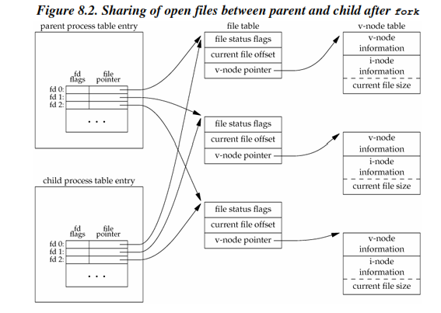

Slide 26
It is important that the parent and the child share the same file offset. Consider a process that forks a child, then waits for the child to complete.
Assume that both processes write to standard output as part of their normal processing. If the parent has its standard output redirected (by a shell, perhaps) it is essential that the parent's file offset be updated by the child when the child writes to standard output.

Slide 27
In this case, the child can write to standard output while the parent is waiting for it; on completion of the child, the parent can continue writing to standard output, knowing that its output will be appended to whatever the child wrote. If the parent and the child did not share the same file offset, this type of interaction would be more difficult to accomplish and would require explicit actions by the parent.
If both parent and child write to the same descriptor, without any form of synchronization, such as having the parent wait for the child, their output will be intermixed (assuming it's a descriptor that was open before the fork).

Slide 28
There are two normal cases for handling the descriptors after a fork.
1. The parent waits for the child to complete. In this case, the parent does not need to do anything with its descriptors. When the child terminates, any of the shared descriptors that the child read from or wrote to will have their file offsets updated accordingly.
2. Both the parent and the child go their own ways. Here, after the fork, the parent closes the descriptors that it doesn't need, and the child does the same thing. This way, neither interferes with the other's open descriptors. This scenario is often the case with network servers.

Slide 29
The two main reasons for fork to fail are
if too many processes are already in the system, or
if the total number of processes for this real user ID exceeds the system's limit. CHILD_MAX specifies the maximum number of simultaneous processes per real user ID.
There are two uses for fork:
1. When a process wants to duplicate itself so that the parent and child can each execute different sections of code at the same time. This is common for network servers—the parent waits for a service request from a client. When the request arrives, the parent calls fork and lets the child handle the request. The parent goes back to waiting for the next service request to arrive.
2. When a process wants to execute a different program. This is common for shells. In this case, the child does an exec right after it returns from the fork.

Slide 30
vfork Function
The function vfork has the same calling sequence and same return values as fork. But the semantics of the two functions differ.
The vfork function is intended to create a new process when the purpose of the new process is to exec a new program (step 2 at the end of the previous section).

Slide 31
The vfork function creates the new process, just like fork, without copying the address space of the parent into the child, as the child won't reference that address space; the child simply calls exec (or exit) right after the vfork.
Instead, while the child is running and until it calls either exec or exit, the child runs in the address space of the parent.
This optimization provides an efficiency gain on some paged virtual-memory implementations of the UNIX System.

Slide 32
Another difference between the two functions is that vfork guarantees that the child runs first, until the child calls exec or exit.
When the child calls either of these functions, the parent resumes. (This can lead to deadlock if the child depends on further actions of the parent before calling either of these two functions.)

Slide 33
exit Functions
A process can terminate normally in five ways:
Executing a return from the main function. This is equivalent to calling exit.
2. Calling the exit function. This function is defined by ISO C and includes the calling of all exit handlers that have been registered by calling atexit and closing all standard I/O streams.
3. Calling the _exit or _Exit function. ISO C defines _Exit to provide a way for a process to terminate without running exit handlers or signal handlers. Whether or not standard I/O streams are flushed depends on the implementation. On UNIX systems, _Exit and _exit are synonymous and do not flush standard I/O streams

Slide 34
4. Executing a return from the start routine of the last thread in the process. The return value of the thread is not used as the return value of the process, however When the last thread returns from its start routine,the process exits with a termination status of 0.
5. Calling the pthread_exit function from the last thread in the process. As with the previous case, the exit status of the process in this situation is always 0, regardless of the argument passed to pthread_exit.

Slide 35
The three forms of abnormal termination are as follows:
1. Calling abort. This is a special case of the next item, as it generates the SIGABRT signal.
2. When the process receives certain signals. The signal
can be generated by the process itself—for example, by calling the abort function—by some other process, or by the kernel. Examples of signals generated by the kernel include the process referencing a memory location not within its address space or trying to divide by 0.
3. The last thread responds to a cancellation request. By default, cancellation occurs in a deferred manner:
one thread requests that another be canceled, and sometime later, the target thread terminates.

Slide 36
Regardless of how a process terminates, the same code in the kernel is eventually executed. This kernel code closes all the open descriptors for the process, releases the memory that it was using, and the like.
For any of the preceding cases, we want the terminating process to be able to notify its parent how it terminated.
For the three exit functions (exit, _exit, and _Exit), this is done by passing an exit status as the argument to the function.

Slide 37
In the case of an abnormal termination, however, the kernel, not the process, generates a termination status to indicate the reason for the abnormal termination. In any case, the parent of the process can obtain the termination status from either the wait or the waitpid function (described in the next section).
Note that we differentiate between the exit status, which is the argument to one of the three exit functions or the return value from main, and the termination status. The exit status is converted into a termination status by the kernel when _exit is finally called. Figure 8.4 describes the various ways the parent can examine the termination status of a child. If the child terminated normally, the parent can obtain the exit status of the child.

Slide 38
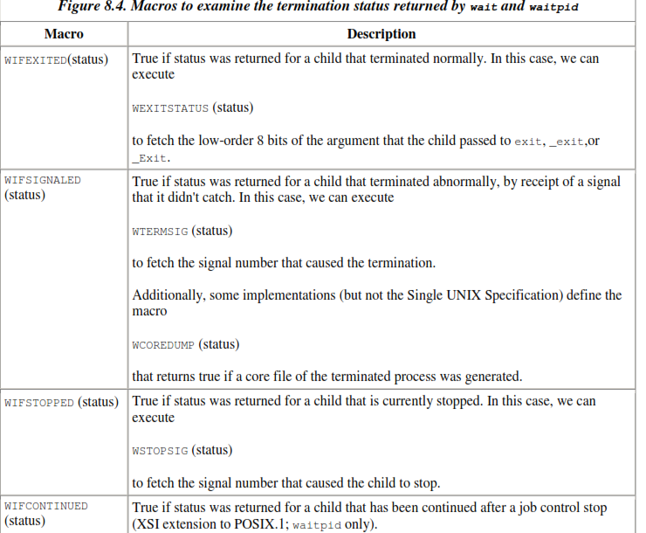

Slide 39
When we described the fork function, it was obvious that the child has a parent process after the call to fork.
Now we're talking about returning a termination status to the parent. But what happens if the parent terminates before the child? The answer is that the init process becomes the parent process of any process whose parent terminates. We say that the process has been inherited by init.
What normally happens is that whenever a process terminates, the kernel goes through all active processes to see whether the terminating process is the parent of any process that still exists. If so, the parent process ID of the surviving process is changed to be 1 (the process ID of init). This way, we're guaranteed that every process has a parent.

Slide 40
Another condition we have to worry about is when a child terminates before its parent. If the child completely disappeared, the parent wouldn't be able to fetch its termination status when and if the parent were finally ready to check if the child had terminated.
The kernel keeps a small amount of information for every terminating process, so that the information is available when the parent of the terminating process calls wait or waitpid.
Minimally, this information consists of the process ID, the termination status of the process, and the amount of CPU time taken by the process. The kernel can discard all the memory used by the process and close its open files.

Slide 41
In UNIX System terminology, a process that has terminated, but whose parent has not yet waited for it, is called a zombie. The ps(1) command prints the state of a zombie process as Z.
If we write a long-running program that forks many child processes, they become zombies unless we wait for them and fetch their termination status.

Slide 42
wait and waitpid Functions
When a process terminates, either normally or abnormally, the kernel notifies the parent by sending the SIGCHLD signal to the parent.
Because the termination of a child is an asynchronous event—it can happen at anytime while the parent is running—this signal is the asynchronous notification from the kernel to the parent.
The parent can choose to ignore this signal, or it can provide a function that is called when the signal occurs: a signalhandler. The default action for this signal is to be ignored.

Slide 43
We need to be aware that a process that calls wait or waitpid can
• Block, if all of its children are still running
• Return immediately with the termination status of a child, if a child has terminated and is waiting for its termination status to be fetched
• Return immediately with an error, if it doesn't have any child processes
If the process is calling wait because it received the SIGCHLD signal, we expect wait to return immediately. But if we call it at any random point in time, it can block.

Slide 44
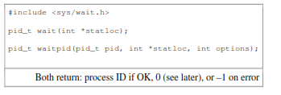

Slide 45
For both functions, the argument statloc is a pointer to an integer. If this argument is not a null pointer, the termination status of the terminated process is stored in the location pointed to by the argument.
If we don't care about the termination status, we simply pass a null pointer as this argument.

Slide 46
The differences between these two functions are as follows.
• The wait function can block the caller until a child process terminates, whereas waitpid has an option that prevents it from blocking. The waitpid function doesn't wait for the child that terminates first; it has a number of options that control which process it waits for.
• If a child has already terminated and is a zombie, wait returns immediately with that child's status. Otherwise, it blocks the caller until a child terminates. If the caller blocks and has multiple children, wait returns when one terminates. We can always tell which child terminated, because the process ID is returned by the function.

Slide 47
With wait, the only real error is- if the calling process has no children.
With waitpid, however, it's also possible to get an error if the specified process or process group does not exist or is not a child of the calling process.

Slide 48
As we mentioned, if we have more than one child, wait returns on termination of any of the children. What if we want to wait for a specific process to terminate (assuming we know which process ID we want to wait for)?
Soln: This functionality (and more) is provided by the POSIX.1 waitpid function.

Slide 49
The interpretation of the pid argument for waitpid depends on its value:
pid == –1
Waits for any child process. In this respect, waitpid is equivalent to wait.
pid > 0
Waits for the child whose process ID equals pid.
pid== 0
Waits for any child whose process group ID equals that of the calling process.
pid< –1
Waits for any child whose process group ID equals the absolute value of pid.

Slide 50
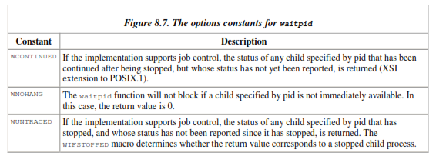
The waitpid function returns the process ID of the child that terminated and stores the child's termination status in the memory location pointed to by statloc.
The options argument lets us further control the operation of waitpid. This argument is either 0 or is constructed from the bitwise OR of the constants in Figure 8.7.

Slide 51
The waitpid function provides three features that aren't provided by the wait function.
1. The waitpid function lets us wait for one particular process, whereas the wait function returns the status of any terminated child.
2. The waitpid function provides a nonblocking version of wait. There are times when we want to fetch a child's status, but we don't want to block.
3. The waitpid function provides support for job control with the WUNTRACED and WCONTINUED options.

Slide 52

waitid Function
The waitid function is similar to waitpid, but provides extra flexibility. It includes an additional function to retrieve the exit status of a process.

Slide 53
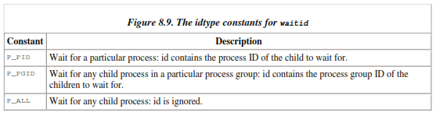
Like waitpid, waitid allows a process to specify which children to wait for.
Instead of encoding this information in a single argument combined with the process ID or process group ID, two separate arguments are used. The id parameter is interpreted based on the value of idtype.
The types supported are summarized in Figure 8.9.

Slide 54
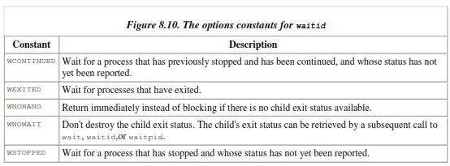
The options argument is a bitwise OR of the flags shown in Figure 8.10. These flags indicate which state changes the caller is interested in.

Slide 55
Most UNIX system implementations provide two additional functions: wait3 and wait4.
The only feature provided by these two functions that isn't provided by the wait, waitid, and waitpid functions is an additional argument that allows the kernel to return a summary of the resources used by the terminated process and all its child processes.
The resource information includes such statistics as the amount of user CPU time, the amount of system CPU time, number of page faults, number of signals received, and the like. Figure 8.11 details the various arguments supported by the wait functions.

Slide 56
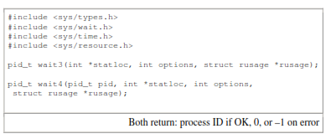

Slide 57
Race Conditions
A race condition occurs when multiple processes are trying to do something with shared data and the final outcome depends on the order in which the processes run.
The fork function is a lively breeding ground for race conditions, if any of the logic after the fork either explicitly or implicitly depends on whether the parent or child runs first after the fork. In general, we cannot predict which process runs first.
Even if we knew which process would run first, what happens after that process starts running depends on the system load and the kernel's scheduling algorithm.

Slide 58
We saw a potential race condition in the program in Figure 8.8 when the second child printed its parent process ID.
If the second child runs before the first child, then its parent process will be the first child. But if the first child runs first and has enough time to exit, then the parent process of the second child is init. Even calling sleep, as we did, guarantees nothing.
If the system was heavily loaded, the second child could resume after sleep returns, before the first child has a chance to run. Problems of this form can be difficult to debug because they tend to work "most of the time."
A process that wants to wait for a child to terminate must call one of the wait functions. If a process wants to wait for its parent to terminate, as in the program from Figure 8.8, a loop of the following form could be used:
while (getppid() != 1)
sleep(1);

Slide 59
The problem with this type of loop, called polling, is that it wastes CPU time, as the caller is awakened every second to test the condition.
To avoid race conditions and to avoid polling, some form of signaling is required between multiple processes. Various forms of interprocess communication (IPC) can also be used.
For a parent and child relationship, we often have the following scenario. After the fork, both the parent and the child have something to do. For example, the parent could update a record in a log file with the child‘s process ID, and the child might have to create a file for the parent.
In this example, we require that each process tell the other when it has finished its initial set of operations, and that each wait for the other to complete, before heading off on its own.

Slide 60
The code in the fig illustrates this scenario:
The five routines TELL_WAIT, TELL_PARENT, TELL_CHILD, WAIT_PARENT, and WAIT_CHILD can be either macros or functions.
Let's look at an example that uses these five routines.

Slide 61
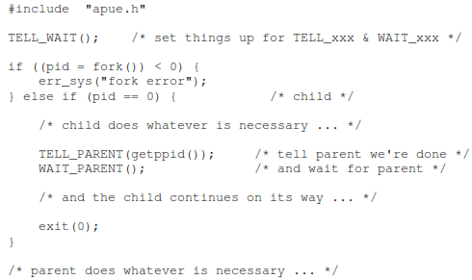
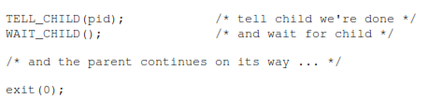

Slide 62
Program with a race condition
#include "apue.h"
static void charatatime(char *);
int main(void)
{
pid_t pid;
if ((pid = fork()) < 0) {
err_sys("fork error");
} else if (pid == 0) {
charatatime("output from child\n");
} else {
charatatime("output from parent\n");
}
exit(0);
}
static void charatatime(char *str)
{
char *ptr;
int c;
setbuf(stdout, NULL); /* set unbuffered */
for (ptr = str; (c = *ptr++) != 0; )
putc(c, stdout);
}

Slide 63
$ ./a.out
ooutput from child
utput from parent
$ ./a.out
ooutput from child
utput from parent
$ ./a.out
output from child
output from parent

Slide 64
Modification to avoid race condition
#include "apue.h"
static void charatatime(char *);
int main(void)
{
pid_t pid;
+ TELL_WAIT();
+
if ((pid = fork()) < 0) {
err_sys("fork error");
} else if (pid == 0) {
+ WAIT_PARENT(); /* parent goes first */
charatatime("output from child\n");
} else {
charatatime("output from parent\n");
+ TELL_CHILD(pid);
}
exit(0);
}
static void
charatatime(char *str)
{
char *ptr;
int c;
setbuf(stdout, NULL); /* set unbuffered */
for (ptr = str; (c = *ptr++) != 0; )
putc(c, stdout);
}

Slide 65
When we run this program, the output is as we expect; there is no intermixing of output from the two processes.
In the program, the parent goes first. The child goes first if we change the lines following the fork to be
} else if (pid == 0) {
charatatime("output from child\n");
TELL_PARENT(getppid());
} else {
WAIT_CHILD(); /* child goes first */
charatatime("output from parent\n");
}

Slide 66
exec Functions
one use of the fork function is to create a new process (the child) that then causes another program to be executed by calling one of the exec functions.
When a process calls one of the exec functions, that process is completely replaced by the new program, and the new program starts executing at its main function.
The process ID does not change across an exec, because a new process is not created; exec merely replaces the current process—its text, data, heap, and stack segments—with a brand new program from disk.

Slide 67
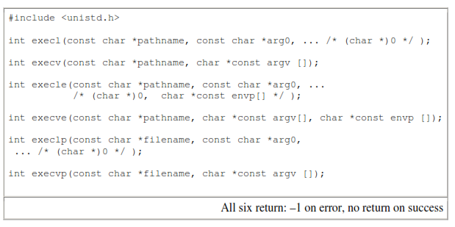

Slide 68
The first difference in these functions is that the first four take a pathname argument, whereas the last two take a filename argument. When a filename argument is specified
• If filename contains a slash, it is taken as a pathname.
• Otherwise, the executable file is searched for in the directories specified by the PATH environment variable.
The PATH variable contains a list of directories, called path prefixes, that are separated by colons. For example,
the name=value environment string
PATH=/bin:/usr/bin:/usr/local/bin/:.
specifies four directories to search. The last path prefix specifies the current directory. (A zero-length prefix also means the current directory. It can be specified as a colon at the beginning of the value, two colons in a row, or a colon at the end of the value.)
If either execlp or execvp finds an executable file using one of the path prefixes, but the file isn't a machine executable that was generated by the link editor, the function assumes that the file is a shell script and tries to invoke /bin/sh with the filename as input to the shell.

Slide 69
The second difference concerns the passing of the argument list (l stands for list and v stands for vector).
The functions execl, execlp, and execle require each of the command-line arguments to the new program to be specified as separate arguments. We mark the end of the arguments with a null pointer.
For the other three functions (execv, execvp, and execve), we have to build an array of pointers to the arguments, and the address of this array is the argument to these three functions.

Slide 70
The final difference is the passing of the environment list to the new program. The two functions whose names end in an e (execle and execve) allow us to pass a pointer to an array of pointers to the environment strings.
The other four functions, however, use the environ variable in the calling process to copy the existing environment for the new program.

Slide 71
The arguments for these six exec functions are difficult to remember. The letters in the function names help somewhat.
The letter p means that the function takes a filename argument and uses the PATH environment variable to find the executable file.
The letter l means that the function takes a list of arguments and is mutually exclusive with the letter v, which means that it takes an argv[] vector.
Finally, the letter e means that the function takes an envp[] array instead of using the current environment.

Slide 72
We've mentioned that the process ID does not change after an exec, but the new program inherits additional properties from the calling process:
• Process ID and parent process ID
• Real user ID and real group ID
• Supplementary group IDs
• Process group ID
• Session ID
• Controlling terminal
• Time left until alarm clock
• Current working directory
• Root directory
• File mode creation mask
• File locks
• Process signal mask
• Pending signals
• Resource limits
• Values for tms_utime, tms_stime, tms_cutime, and tms_cstime

Slide 73
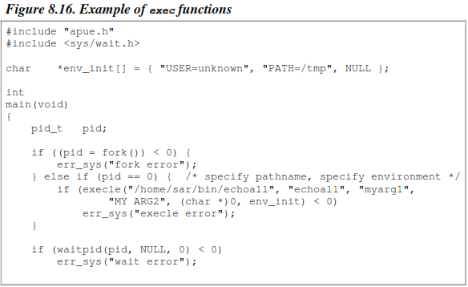
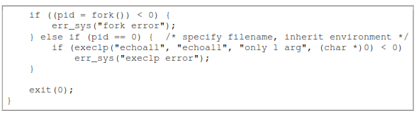

Slide 74
When we execute the program from Figure 8.16, we get
$ ./a.out
argv[0]: echoall
argv[1]: myarg1
argv[2]: MY ARG2
USER=unknown
PATH=/tmp
$ argv[0]: echoall
argv[1]: only 1 arg
USER=sar
LOGNAME=sar
SHELL=/bin/bash
47 more lines that aren't shown
HOME=/home/sar
Note that the shell prompt appeared before the printing of argv[0] from the second exec. This is because the parent did not wait for this child process to finish.

Slide 75
Interpreter Files
These files are text files that begin with a line of the form
#! pathname [ optional-argument ]
The space between the exclamation point and the pathname is optional.
The most common of these interpreter files begin with the line
#!/bin/sh

Slide 76
The pathname is normally an absolute pathname, since no special operations are performed on it. i.e., PATH is not used).
The recognition of these files is done within the kernel as part of processing the exec system call.
The actual file that gets executed by the kernel is not the interpreter file, but the file specified by the pathname on the first line of the interpreter file. Be sure to differentiate between the interpreter filea text file that begins with #!and the interpreter, which is specified by the pathname on the first line of the interpreter file.

Slide 77
Note that that systems place a size limit on the first line of an interpreter file. This limit includes the #!, the pathname, the optional argument, the terminating newline, and any spaces.

Slide 78
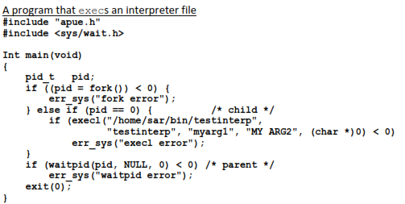

Slide 79
Output:
$ cat /home/sar/bin/testinterp
#!/home/sar/bin/echoarg foo
$ ./a.out
argv[0]: /home/sar/bin/echoarg
argv[1]: foo
argv[2]: /home/sar/bin/testinterp
argv[3]: myarg1
argv[4]: MY ARG2

Slide 80
The program echoarg (the interpreter) just echoes each of its command-line arguments.
Note that when the kernel execs the interpreter (/home/sar/bin/echoarg), argv[0] is the pathname of the interpreter, argv[1] is the optional argument from the interpreter file, and the remaining arguments are the pathname (/home/sar/bin/testinterp) and the second and third arguments from the call to execl in the program (myarg1 and MY ARG2).
Both argv[1] and argv[2] from the call to execl have been shifted right two positions. Note that the kernel takes the pathname from the execl call instead of the first argument (testinterp), on the assumption that the pathname might contain more information than the first argument.

Slide 81
Interpreter files are useful for the following reasons:
They hide that certain programs are scripts in some other language.
Interpreter scripts provide an efficiency gain i.e we can hide the program by it in a shell script.
Interpreter scripts let us write shell scripts using shells other than /bin/sh. When it finds an executable file that isn't a machine executable, execlp has to choose a shell to invoke, and it always uses /bin/sh. Using an interpreter script, however, we can simply write
#!/bin/csh
(C shell script follows in the interpreter file)

Slide 82
system Function
#include <stdlib.h>
int system(const char *cmdstring);
It is convenient to execute a command string from within a program.
If cmdstring is a null pointer, system returns nonzero only if a command processor is available.
This feature determines whether the system function is supported on a given operating system. Under the UNIX System, system is always available.

Slide 83
Because system is implemented by calling fork, exec, and waitpid, there are three types of return values.
✓ If either the fork fails or waitpid returns an error other than EINTR, system returns 1 with errno set to indicate the error.
✓ If the exec fails, implying that the shell can't be executed, the return value is as if the shell had executed exit(127).
✓ Otherwise, all three functions fork, exec, and waitpid succeed, and the return value from system is the termination status of the shell, in the format specified for waitpid.

Slide 84
Program:
The system function, without signal handling

Slide 85
#include <sys/wait.h>
#include <errno.h>
#include <unistd.h>
int system(const char *cmdstring) /* version without signal handling */
{
pid_t pid;
int status;
if (cmdstring == NULL)
return(1); /* always a command processor with UNIX */
if ((pid = fork()) < 0) {
status = -1; /* probably out of processes */
} else if (pid == 0) { /* child */
execl("/bin/sh", "sh", "-c", cmdstring, (char *)0);
_exit(127); /* execl error */
} else { /* parent */
while (waitpid(pid, &status, 0) < 0) {
if (errno != EINTR) {
status = -1; /* error other than EINTR from waitpid() */
break;
}
}
}
return(status);
}

Slide 86
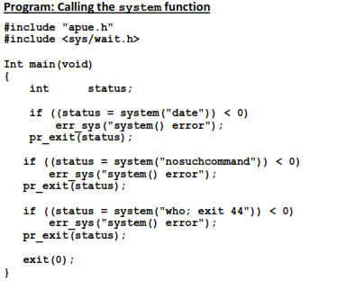

Slide 87
output
$ ./a.out
Sun Mar 21 18:41:32 EST 2004
normal termination, exit status = 0 for date
sh: nosuchcommand: command not found
normal termination, exit status = 127 for nosuchcommand
sar :0 Mar 18 19:45
sar pts/0 Mar 18 19:45 (:0)
sar pts/1 Mar 18 19:45 (:0)
sar pts/2 Mar 18 19:45 (:0)
sar pts/3 Mar 18 19:45 (:0)
normal termination, exit status = 44 for exit

Slide 88
The advantage in using system, instead of using fork and exec directly, is that system does all the required error handling all the required signal handling.
Set-User-ID Programs
What happens if we call system from a set-user-ID program? Doing so is a security hole and should never be done.
Following program shows a simple program that just calls system for its command-line argument.

Slide 89
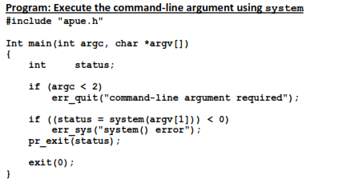

Slide 90
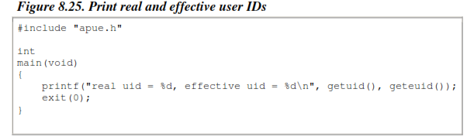

Slide 91
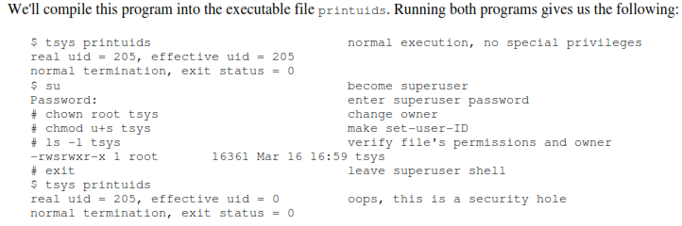

Slide 92
The superuser permissions that we gave the tsys program are retained across the fork and exec that are done by system.
If it is running with special permissions—either set-user-ID or set-group-ID—and wants to spawn another process, a process should use fork and exec directly, being certain to change back to normal permissions after the fork, before calling exec.
The system function should never be used from a set-user-ID or a set-group-ID program.

Slide 93
Thank you…….

